Slide 1
Profiling Network Performance for Multi-Tier Data Center Applications
By Princeton University and Microsoft
Jaya Godugu

Slide 2
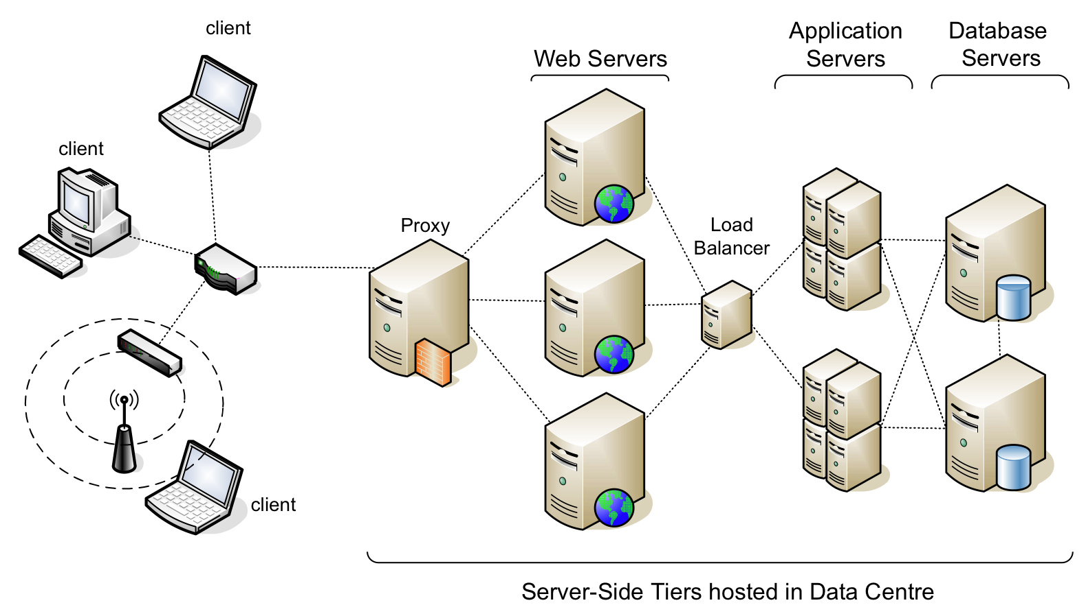
The context – many applications co existing across multiple tiers

Slide 3
What’s the problem in this context?
Often great infrastructure but low throughput
Things can go wrong in
Application software
Network stack
Send and Recv buffers
The network itself
Whom to blame?

Slide 4
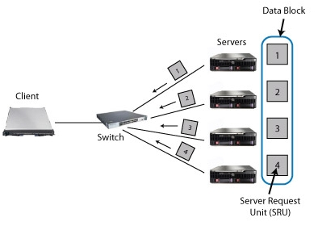
Examples of problems: The (in)famous TCP incast

Slide 5
Examples of problems: under utilization of the bandwidth
Nagle’s algorithm
Delayed Ack
Fast Retransmission
Silly Window Syndrome
Small send buffer

Slide 6
Finding the culprit is hard
Traditional profiling approaches and their problems:
Packet Sniffing
Logging every packet and analyzing is very heavy!
Application level logs
No general logging standards, also heavy
SNMP
Too coarse to diagnose

Slide 7
addressing these difficulties – SNAP (scalable network-application profiler)
Lightweight
Generic
Precise (fine grained)
The beneficiaries:
a) developers
b) data center operators

Slide 8
The SNAP philosophy
No Packet sniffing – Socket Level logs
No application logs – TCP statistics
The heuristic:
If Socket logs say A and TCP statistic say B, then the culprit is C
For ex:
If we observe increasing Fast Retransmissions and Timeouts, then the culprit is the network

Slide 9
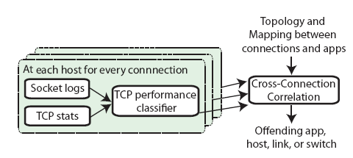
Classification & Correlation
SNAP knows the whole topology
SNAP knows the application to server mappings

Slide 10
Profiling: Scalable
Profiling: Fine Grained
Generic
Low Overhead
Socket Information

Slide 11
Socket Information
TCP –Level Statistics
Socket Logs
Instantaneous values
Cumulative values
Read/Write Bytes

Slide 12
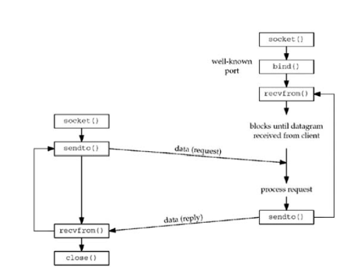
Socket Information Through TCP Statistics & Socket logs
Server
Client
Timeout, RTT, CurrAppWQueue
Rwin,Cwin,CwinLimitTime

Slide 13
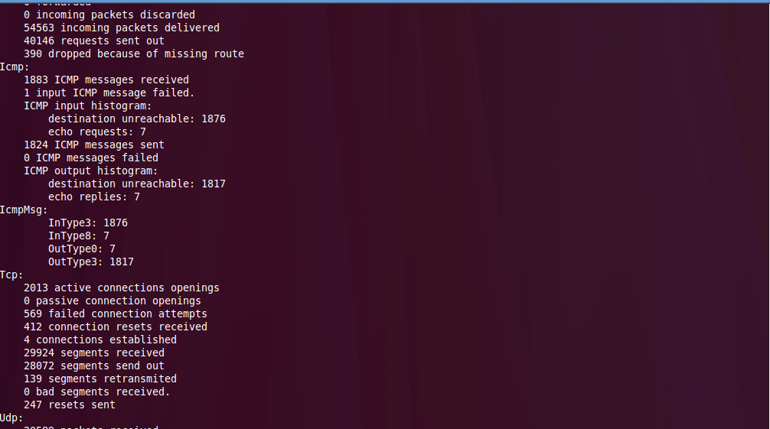
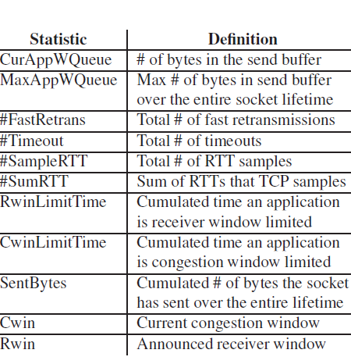
Some of the widely used TCP-level statistics
Real-Time TCP Statistics

Slide 14
Performance classifier
Application
Receiver
Network
Send Buffer

Slide 15
Correlation
Connections across an application
Connections across a resource

Slide 16
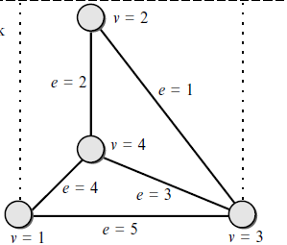


Correlation: Connections across a resource
A resource ‘S1’ shared by several connections
S1→ Switch, link etc..
Checks if the performance problems occurs across connections using the same resource ‘s1’
Correlation: Connections across an application
N connections across the same application
N → bind(), connect() etc..
Checks if the performance problems occurs across many connections using the same Application A , across different machines different time

Slide 17

Average Correlation Coefficient
For a given value of:
S ( connections sharing a resource/ of the same application)
T( time in hours, minutes/ Days)
Performance vector is constructed
t→ Aggregation time interval in T
Ci → Problem in the specified connection

Slide 18
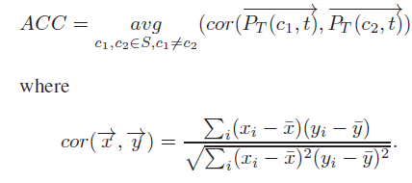

ACC(Average correlation coefficient) is calcultated :
If ACC then connections in S have a problem

Slide 19
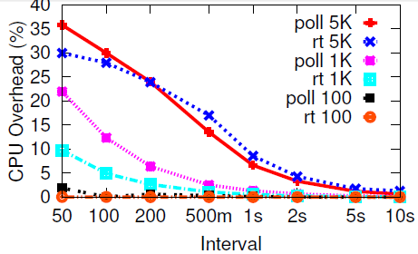
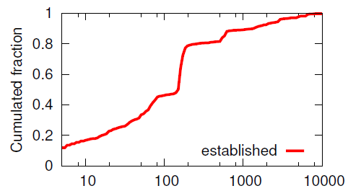
Results

Slide 20
Conclusion
SNAP combines socket-call logs of the application’s desired data-transfer behaviors with TCP statistics from the network stack that highlight the delivery of data.
SNAP leverages the knowledge of topology, routing, and application deployment in the data center to correlate performance problems among connections, to pinpoint the congested resource or problematic software component.

